Slide 1


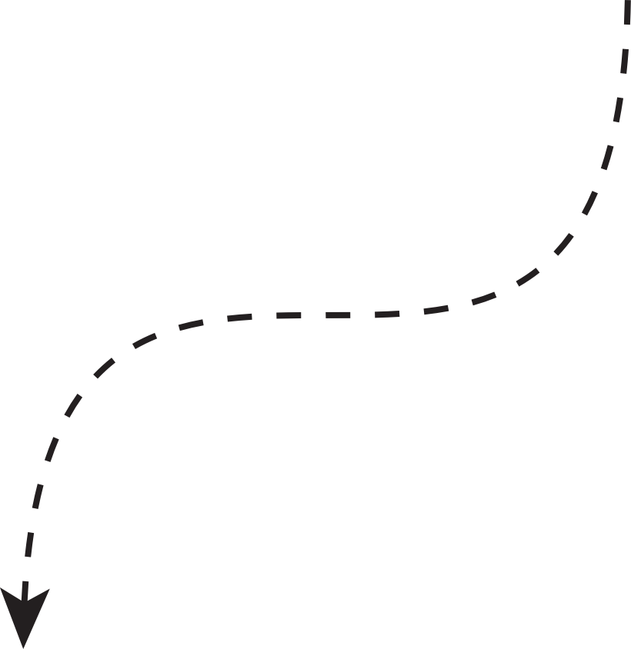


By Team KSHEMANKARI
CARE
COMPANION

Slide 2





THE TEAM
  Rishad Ababil Aebong (Leader, Circuit and Electronics specialist)
  Swastika Dutta (Hardware and mechanical designer)
  Songhita Dutta (Logistics Coordinator)

Slide 3








PROJECT DETAILS (HARDWARE)
•Core components and functions:
• ESP32 — main controller with Wi‑Fi & Bluetooth for connectivity.
• HuskyLens — on-device AI vision for pill recognition and object detection.
• MAX30102 — optical sensor for heart rate & SpO2 monitoring.
• MPU6050 — accelerometer + gyroscope for motion and fall detection.
• OLED display & buzzer— visual and beeping reminders.
• GPS module — provides location when help is needed.

Slide 4



Fall Detection
Fall Detection
  MPU6050 data is filtered and analyzed to detect falls; thresholds tuned to avoid false alarms.
  Successful detection of simulated falls during trials.
Programming & Results
Heart Rate
Heart rate
  MAX30102 routines read IR/Red signals to compute BPM and estimate SpO2 values
  Heart & SpO2 readings close to a finger pulse-oximeter in tests.
Medicine Information
Medicine Information
  Vision routines train HuskyLens for pill recognition (on-device learning).
  Accurate pill recognition in trained samples.

Slide 5
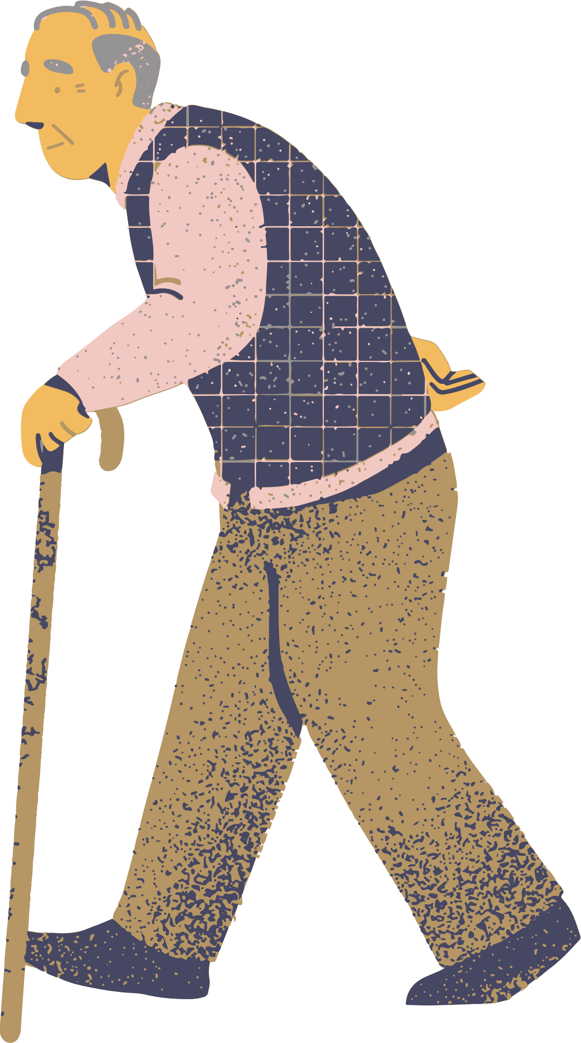
BENEFITS OF CARECOMPANION
Improves medication adherence through timed visual + buzzer.
Always with you when you need it
Becomes Your Companion
Becomes Your Medication Buddy
Detects falls and alerts caregivers with location.
Monitors vital signs and provides quick feedback.
Always knows your heart
Always with you during emergencies
Tracks progress and notifies caretakers
Automatically alerts designated caregivers.
Monitored through an app
An immediate alert system.

Slide 6

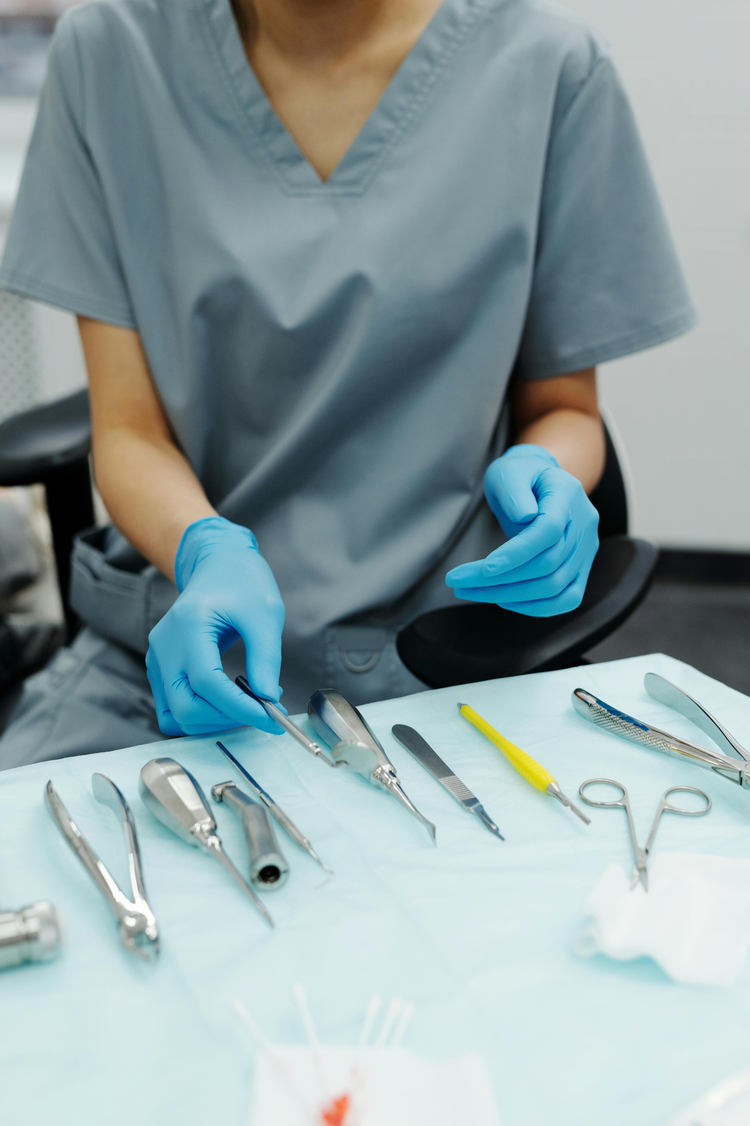
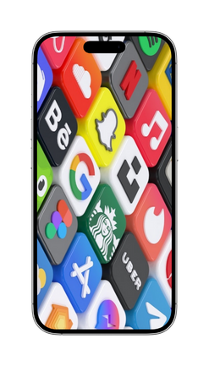



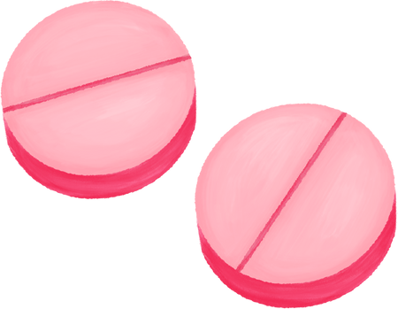
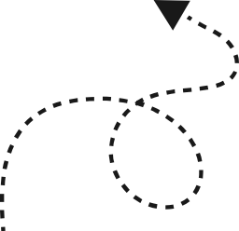
FUTURE UPGRADES
EXPREMELY PRECISE AND RELIABLE LOCATION TRACKING
Enhance our mobile apps for a better user experience
IMPROVED AI FOR PILL RECOGNITION (USE MORE DATASETS AND AUGMENTATION).

Slide 7




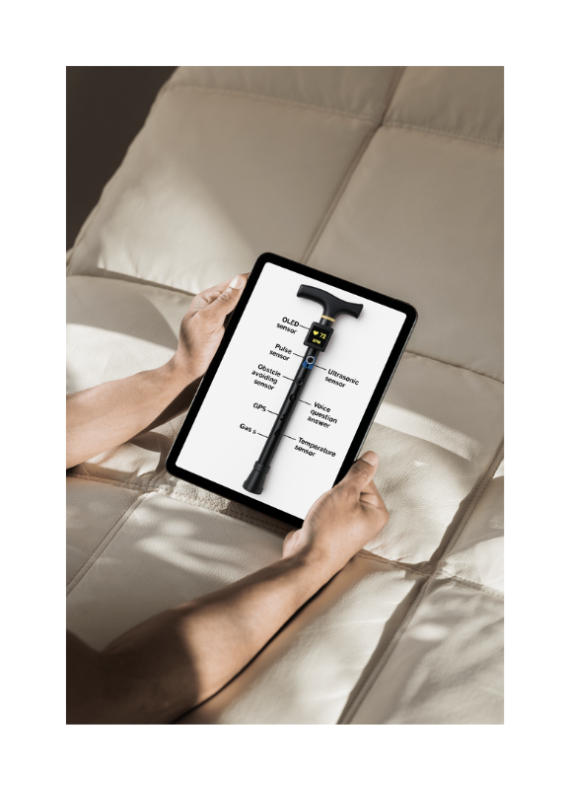

CARE COMPANION
  VISION
To create a world where aging with independence, dignity, and safety is supported by compassionate technology.
  MISSION
TO EMPOWER OLDER ADULTS WITH A SAFE, RELIABLE, AND INTELLIGENT WALKING COMPANION THAT MONITORS HEALTH, DETECTS FALLS, AND ENSURES PEACE OF MIND FOR BOTH USERS AND THEIR LOVED ONES.

Slide 8






CONCLUSIONS
CONCLUSION 3
CONCLUSION 1
CONCLUSION 2
The CareCompanion smart walking stick enhances safety and independence for older adults by monitoring vital signs and detecting falls in real time.
It provides peace of mind for both users and their families through smart tracking and health alerts.
By combining assistive mobility with intelligent health features, it represents a holistic solution for aging with dignity and confidence.

Slide 9
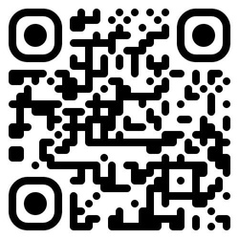



THANK
YOU!
PRESENTED TO YOU BY TEAM KSHEMANKARI
DISCOVER MORE
ONLINE

